Slide 1
Digital Economics
Department of Computer Science and Engineering,
Rajarambapu Institute of Technology, Rajaramnagar

Slide 2
Table of Contents
Introductions and Terms
Digresh and Varun
Globalisation and Evolution
Sonali and Ashish
Sharing Economy
Ankit and Ajay
Earning and Generating Money
Siddhi and Yadnyawalkya
Backend Technology
Ajay and Dushant
Conclusion

Slide 3
Digital Economics
The digital economy is the worldwide network of economic activities enabled by information and communications technologies (ICT). It can also be defined more simply as an economy based on digital technologies. The digital economy is sometimes called the Internet economy, the new economy or Web economy
The digital economy is sometimes called the Internet economy, the new economy or Web economy.
Notes:
Digresh

Slide 4
Key Terms
Digital Economy
Service-based, Sharing,
Collaborative, On-demand
Digital Preneur
Entrepreneur, Minipreneur,
Solopreneur, E- preneur, Free preneur
New Economy
Crowd Sourcing, Crowd Funding,
Peer to-peer lending, Peer-to-peer renting,
Gig employment
Technologies
AI(Artificial Intelligence)
VR(Virtual Reality), Robotics
E-Businesses
Notes:
Digresh

Slide 5






Digital Influence
Digital Dinosaurs
Digital Nomads
Digital Natives
Influence
Digital Currencies
Digital Divide
Disruptive Technologies
Notes:
Varun

Slide 6
Globalization: Then vs. now
20th Century
21st Century
Tangible flows of physical goods.
Flows mainly between advanced economics
Capital and labor intensive flows.
Transportation infrastructure is critical for flows.
Intangible flows of data and information.
Greater participation by emerging economies.
More knowledge intensive flows.
Digital infrastructure becomes equally important
Notes:
Ashish and Sonali

Slide 7
Globalization: Then vs. now
20th Century
21st Century
Multinational companies drive flows.
Flows mainly of monetized transactions.
Ideas diffuse slowly across borders.
Innovation flows from advanced to emerging economics.
Growing role of small enterprises and individuals.
More exchanges of free content and services
Instant global access to information.
Innovation flows in both directions.

Slide 8
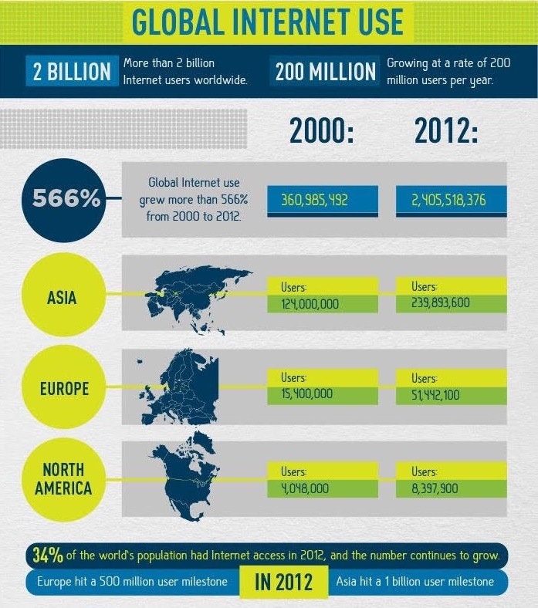
Global Internet Use
The internet accounts for 3.4% of the Gross Domestic Product(GDP) in 13 countries.
It accounts for 21% of GDP growth in last 5 years in mature countries.
For some countries internet is a place of game, keep up with friends, but for many, it’s much more than that.

Slide 9
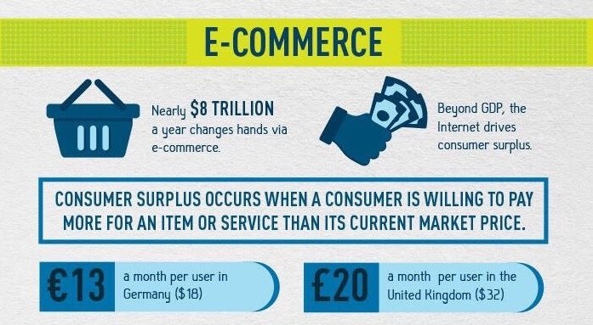
T

Slide 10
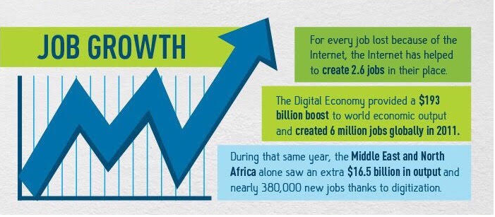
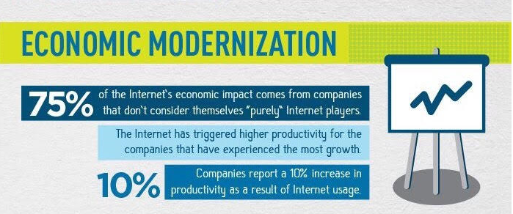
Job Growth and Economic Modernization
Economic modernization
Job growth
$193 billion boost to world economic output.
Created 6 million jobs globally in 2011.
Impact on internet economy.
10% increase in productivity.

Slide 11
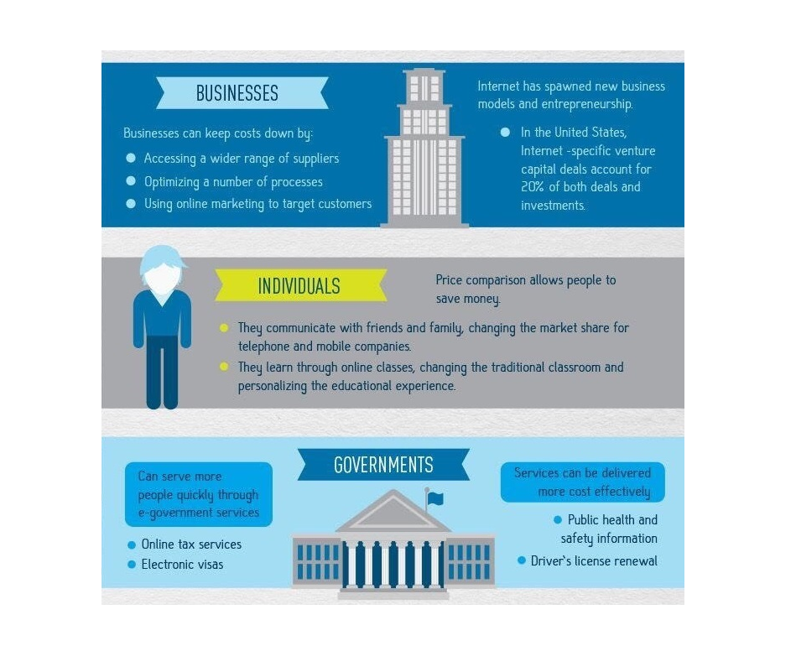
Contribution To Wealth
New business models and entrepreneurship.
Individual communication changed market shares of telecommunication companies.
E-government services.

Slide 12
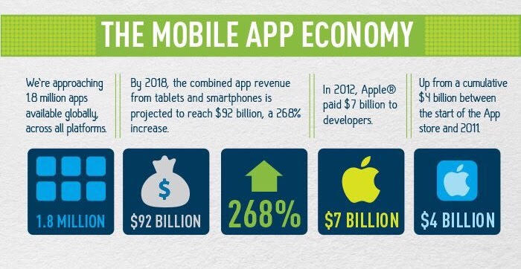
The Mobile App Economy….
2018: 92 billion dollars from smartphones i.e. 268% increase.
March 2017 stats: 2,800,000 registered applications in android market.

Slide 13

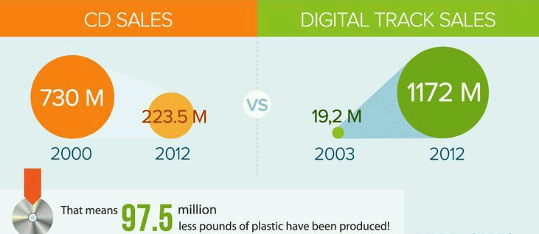
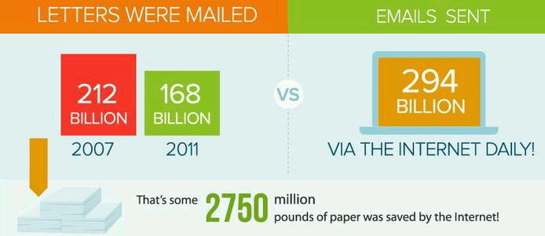
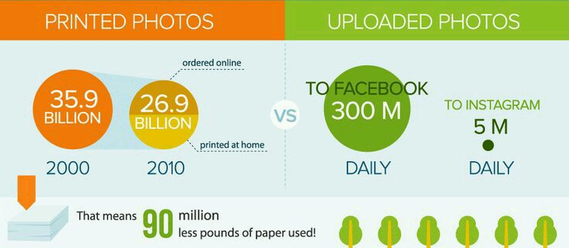
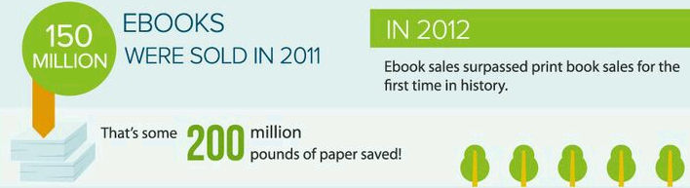
The Rise of Digital Music
Snail Mail to E-mail
From the Dark Room to Computer Room
Saving Paper

Slide 14


Sharing Economy
Notes:
Ankit and Ajay

Slide 15
What is Sharing Economy ?....
Definitions
Economic model
Here individuals are able to borrow or rent assets owned by someone else. The sharing economy model is most likely to be used when the price of a particular asset is high and the asset is not fully utilized all the time.
Socio-economic ecosystem
The Sharing Economy is a socio-economic ecosystem built around the sharing of human, physical and intellectual resources.
Ownership
The Sharing Economy is an economic model based on providing access to goods and services rather than their outright ownership (Peer to peer sharing).

Slide 16
Societal drivers
Economic drivers
Technological drivers
Wastage of resources
Crappy Product
Recession
Inflation
Technology Improvement

Slide 17
Methods to achieve:
Swapping and exchanging
pay-as-you-use economy
collective purchasing
shared ownership
Peer-peer Sharing
collaborative economy

Slide 18
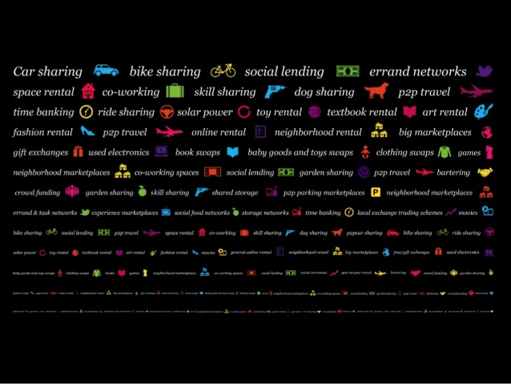

Slide 19
Barriers:
Trust Issues
Don’t know any users, social proof
Time it takes to learn new platform
Insufficient knowledge of how to get started
Scams, privacy and safety risks

Slide 20
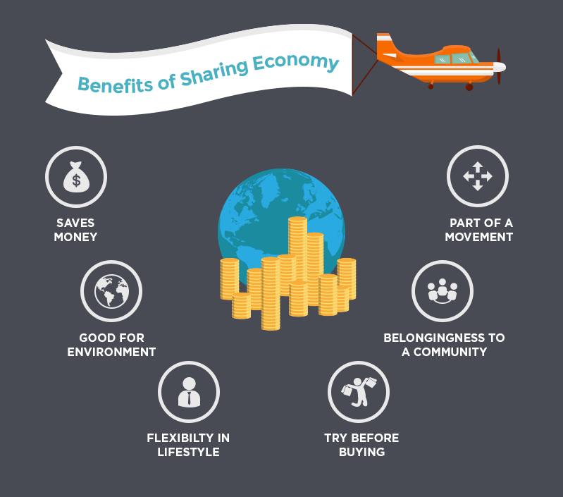

Slide 21
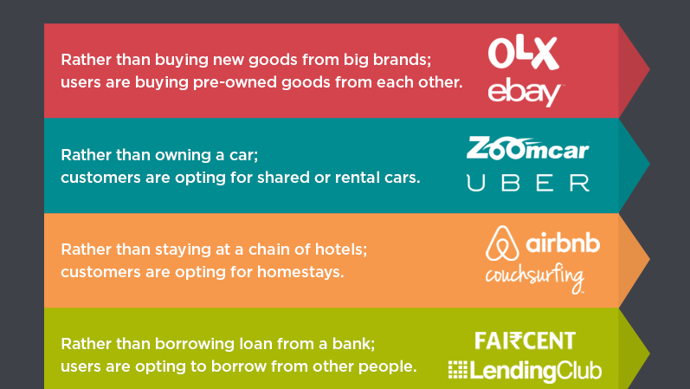

Slide 22
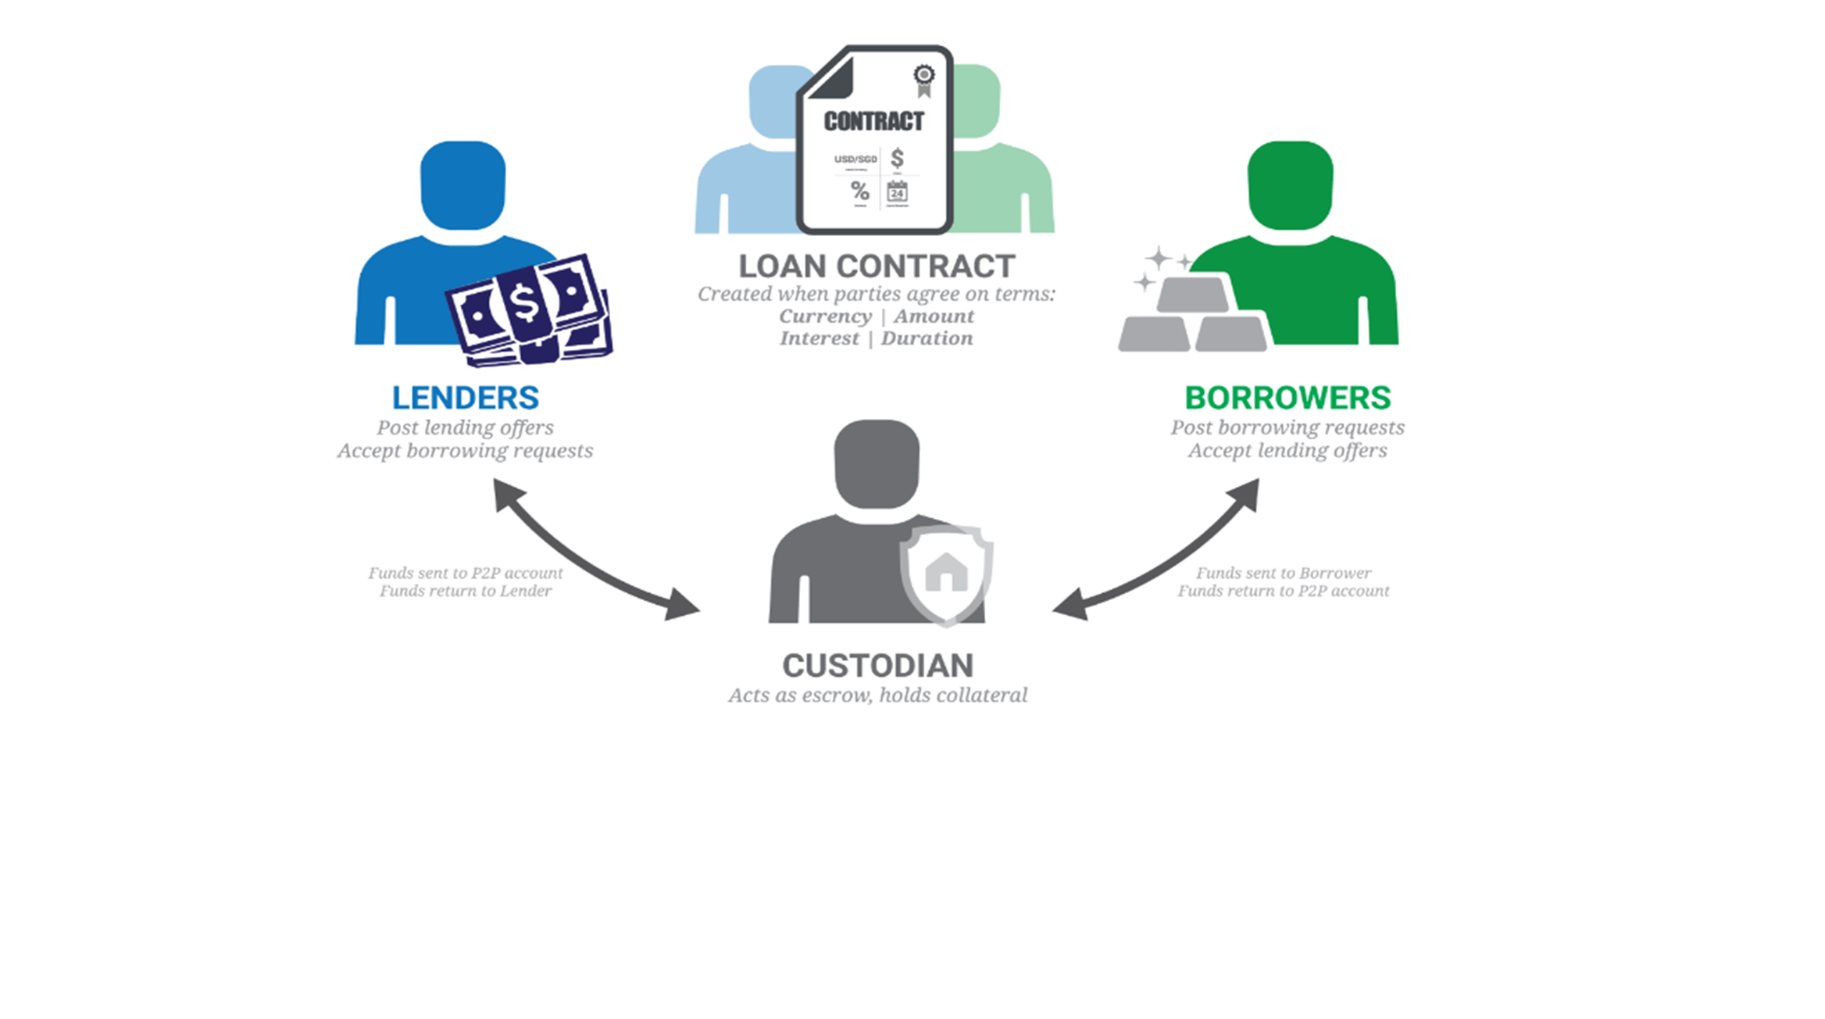

Banking without Bank: Peer-to-Peer Lending
Notes:
Yadnyawalkya and Siddhi

Slide 23
P2P Lending
Pros
Cons
For borrower - Low interest rate (than any banks)
Loss of money
For lender – High rate of return (than any banks)
P2P lending is non regulatory in India
No need to go bank,
Seat calm and enjoy coffee !
Global lending regulated by U.S. Securities and Exchange Commission,

Slide 24




Ways to earn money online
Vlogging
Freelancing
Affiliating
Google Adsense
It’s video+blogging and people share their experiences on websites like YouTube
Self-employed person offering services online, usually to businesses and often to multiple clients at a time
There are hundreds of online merchants like Flipkart, Amazon, eBay, Clickbank etc. where you can signup & promote their products.
Advertising service designed for websites to display advertisements on webpage and earn money when visitors view or click the ads.

Slide 25
https://www.youtube.com/watch?v=8d32Ps1VYAk
The
Business World
of Tomorrow

Slide 26





How to Thrive in the Digital Economy
Dynamic Adaptations
Collaborative Innovation
Product Enhancements
Customer Expectations
Get Technosavvy
Organizational
Leadership

Slide 27
Back-end Technologies of Digital Economics
Network Infrastructure
Smart Devices
IoT (Internet of Things)
Artificial Intelligence
Cloud Computing
Cyber-security
Notes:
Ajay and Dushant

Slide 28
PaaS
How they are linked with Digital ECONOMY ???
1. Cloud
Websites
IaaS
SaaS
2. Virtual Market
Mob Applications

Slide 29
What are Benefits of going DIGITAL ?
Low Cost and Pay per use
Back end technology services are available at very low cost
Metered Service & Customer are charged for service/product is used.
Scalable
Business vendors can scale the capacity and performance whenever required.
Examples
AADHAAR project
BHIM App

Slide 30
Summary
Terms
Globalization and Evolution
Sharing Economy
Earning and Generating
Enabling Technology

Slide 31
THANK YOU !

